Slide 1
BOSCH RESEARCH
Perspective Images → 360° Panorama
1+92 Dataset Construction · Progress Update
Freezing the pipeline into a scalable 1+92 dataset: AV2 sensor logs → 1 perfect 360° frame + 92 scene-band frames
QI PAN
I

Slide 2
DATASET
Dataset: Argoverse 2 Sensor — how much data
1000
150
~300
SENSOR LOGS TOTAL
VAL LOGS · WE START HERE
FRAMES PER LOG
▸ Argoverse 2 Sensor: 1000 driving logs (700 train / 150 val / 150 test), each ~15 s at ~300 frames.
▸ 7 ring cameras give full 360° coverage + LiDAR + 3D annotations.
▸ We start from the 150 val logs and scale toward the full 1000.
II

Slide 3
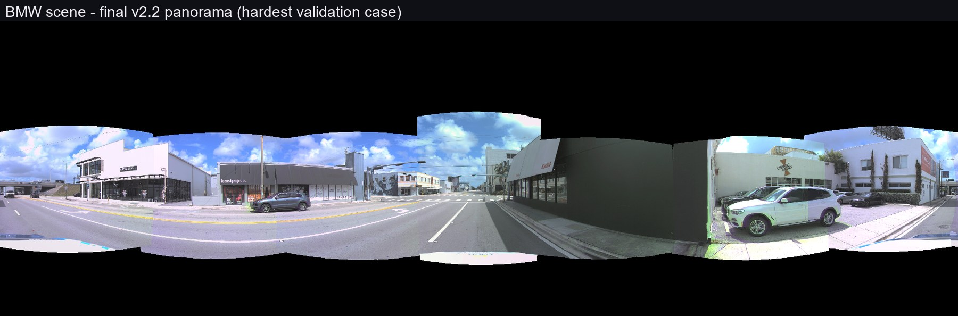
PIPELINE
Pipeline: our algorithm frozen into a repeatable 1+92 flow
① Band-gate — render every frame’s scene band, gate each frame on seam residual (max_reg_px ≤ 8 px), take the longest clean run (≥ 93 frames).
② Frame-1 selection —the imperfect metric (count of nadir pixels lacking real data) picks the most-complete frame as the 360° anchor; general across scenes, zero per-scene tuning.
③ Complete + package — real ground (multi-camera + temporal reprojection) + FLUX sky outpaint + FLUX blind-spot fill → one perfect frame-1; pack 1 perfect frame + 92 scene-band frames = one 1+92 sample.
IV

Slide 4
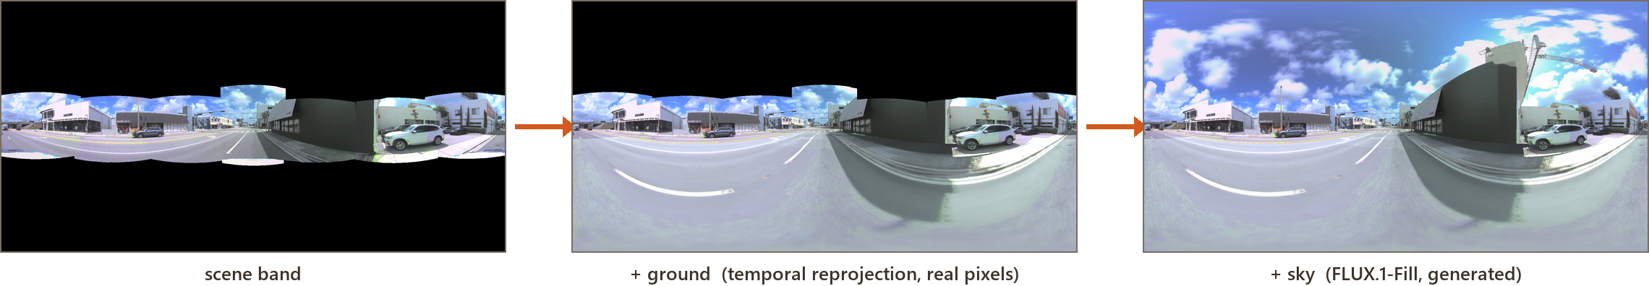
COMPUTE & THROUGHPUT
Compute & throughput: what one log costs
HARDWARE — 4 machines, 44 CPU cores
THROUGHPUT — S3 to local SSD
4 runtimes = 1×A100 + 2×L4 + 1×T4 = 44 CPU cores.
Band-gate is CPU-bound — GPU sits at 0% util, so cheap L4/T4 cores do the heavy lifting.
FLUX (sky + blind-spot fill) runs on the A100.
Key speed-up s5cmd pulls each log from the public AV2 S3 to local SSD, ~90× faster than reading Drive.
Saturated all 4 machines’ CPUs are then fully saturated (load 12–16).
Time / log ___ min (measuring the saturated run; the un-optimized Drive-I/O version was ~73 min).
V

Slide 5
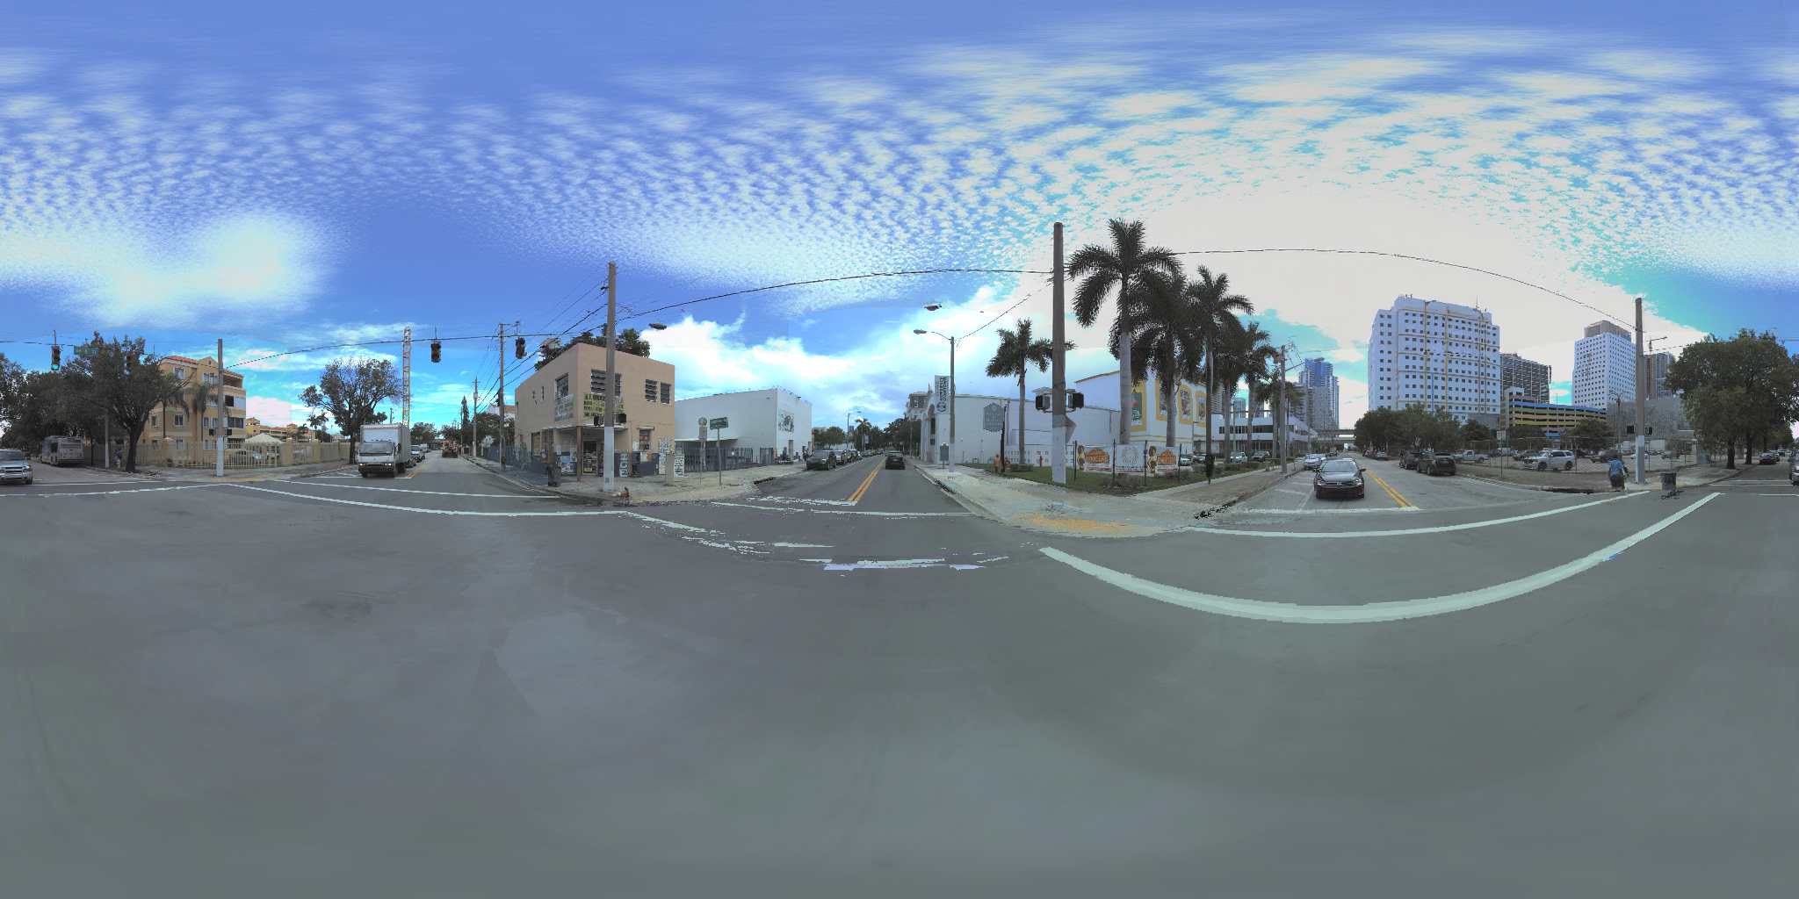

Slide 6
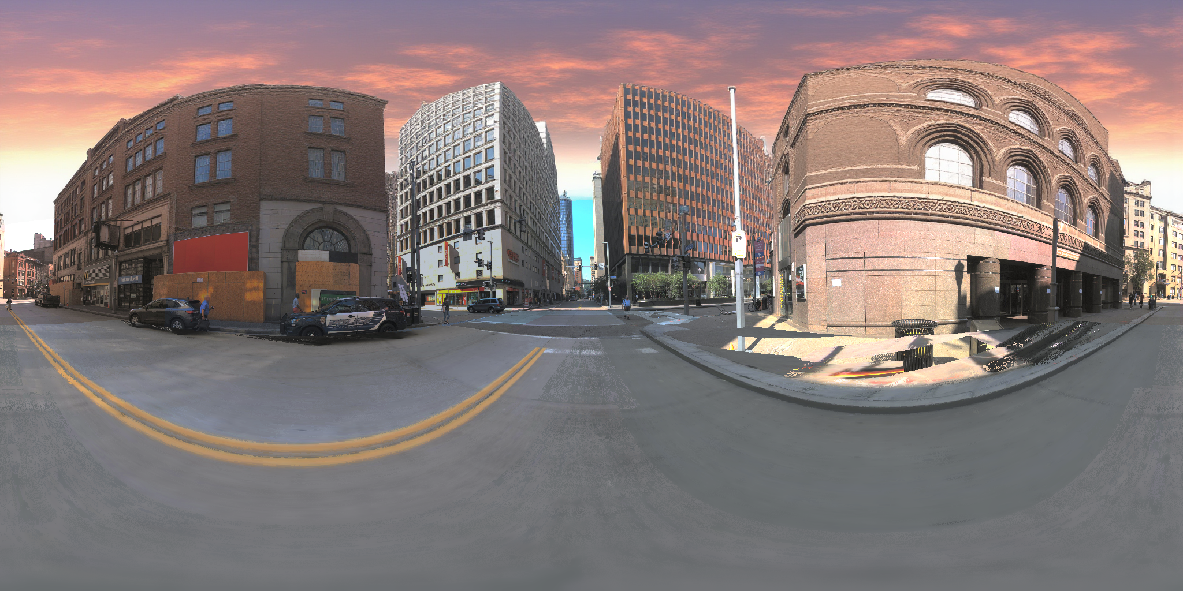
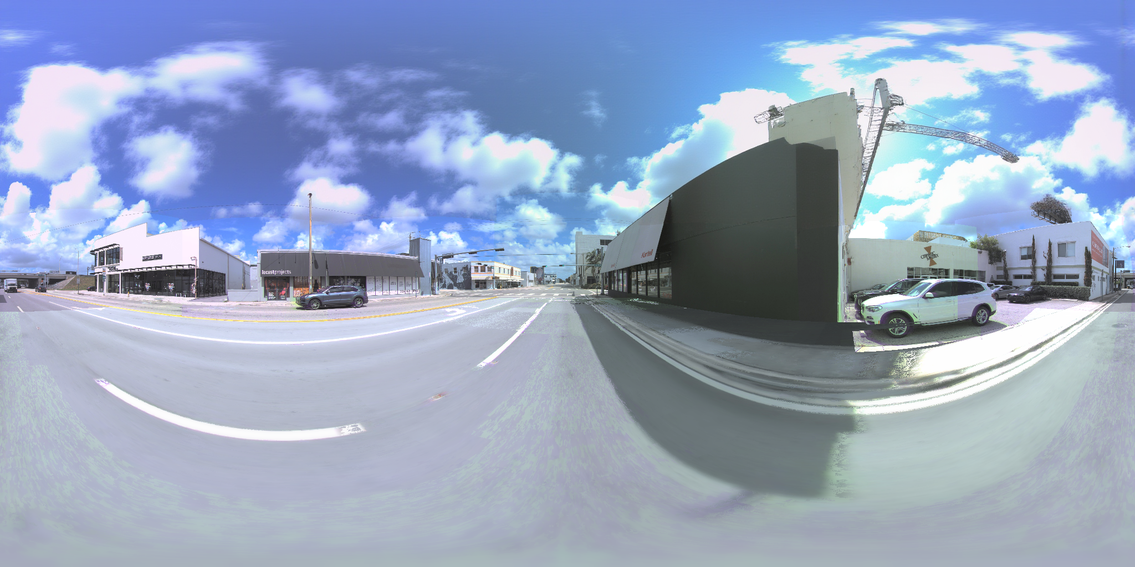
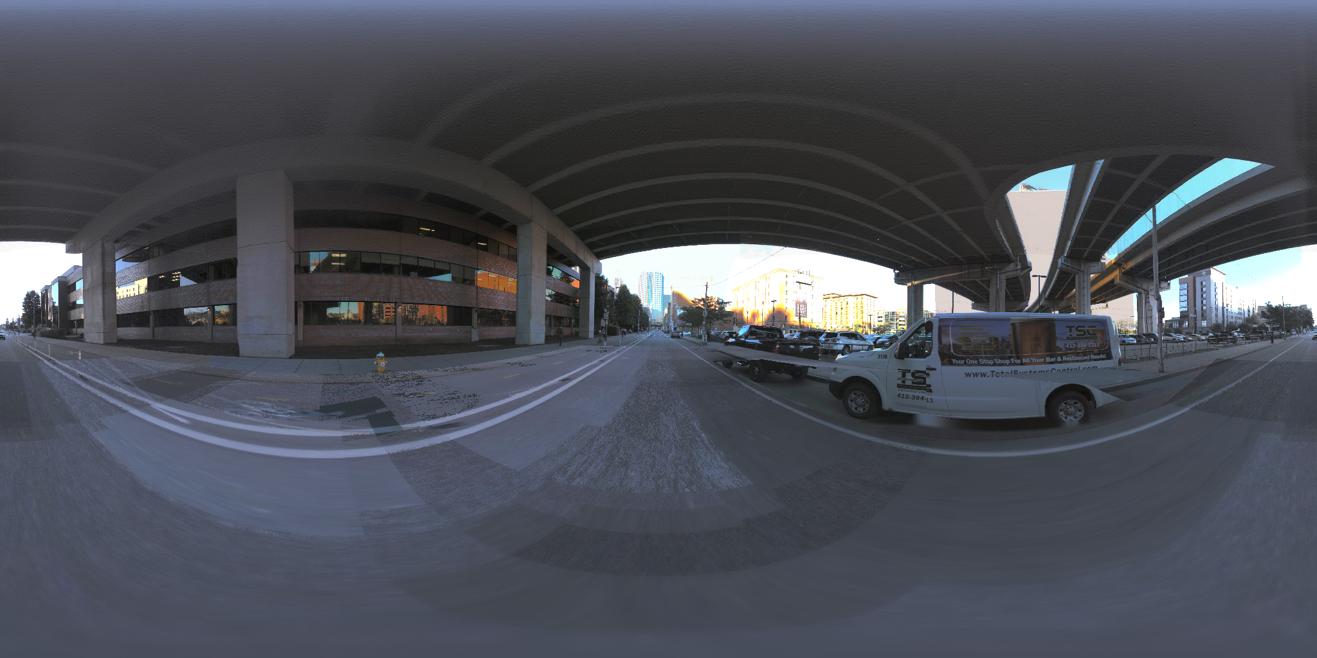
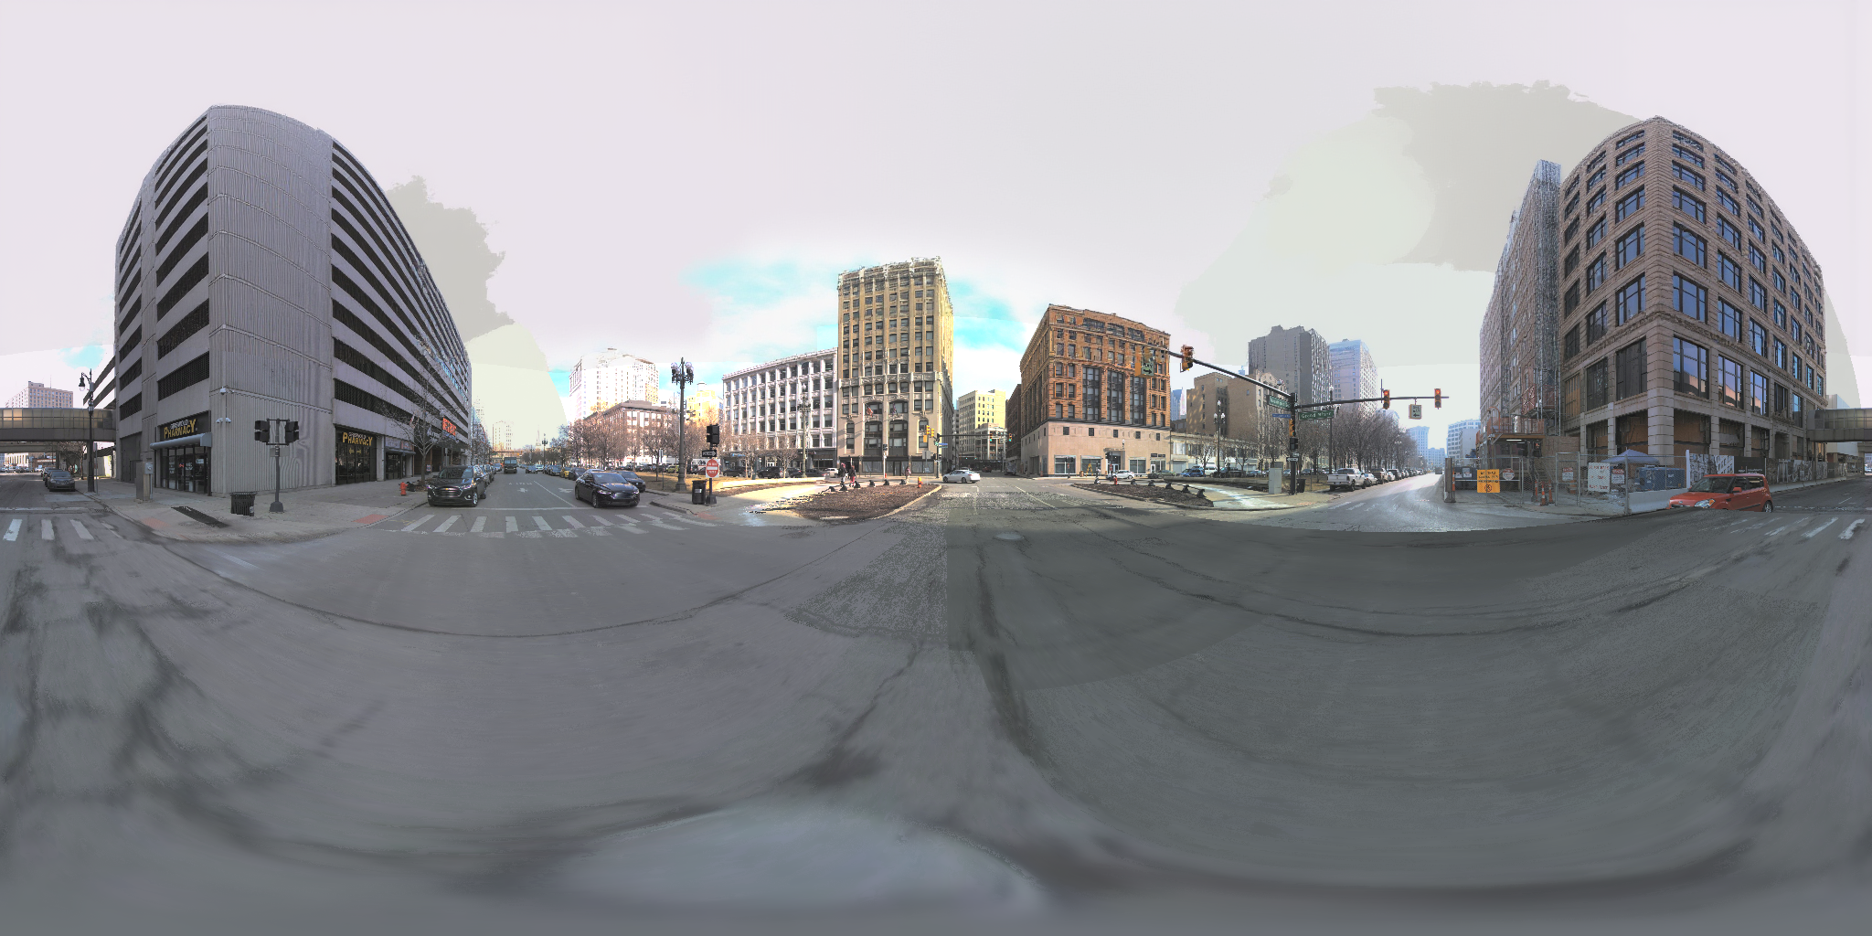
PROGRESS
Progress: 1+92 samples built so far
VI

